Slide 1
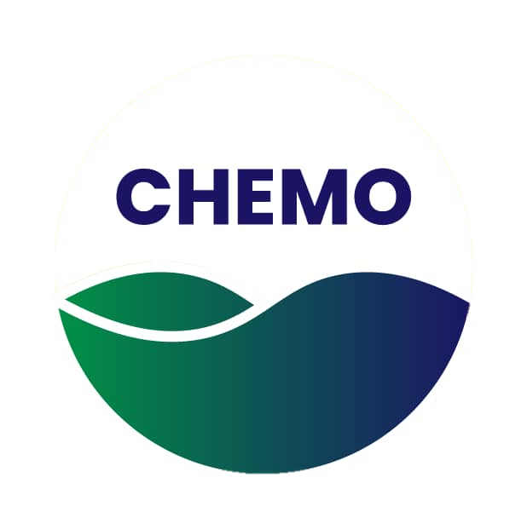
Chemosynthetic Realms By: Space Lords

Slide 2
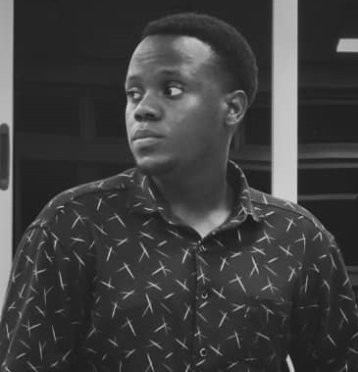
2
Hello!
I am Nuwarimpa Victor
I am from space lords team of four members
You can find me at victornuwarimpa@gmail.com

Slide 3
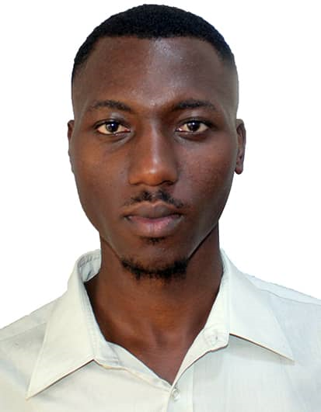
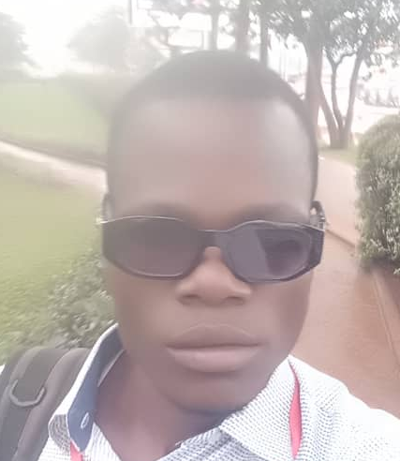
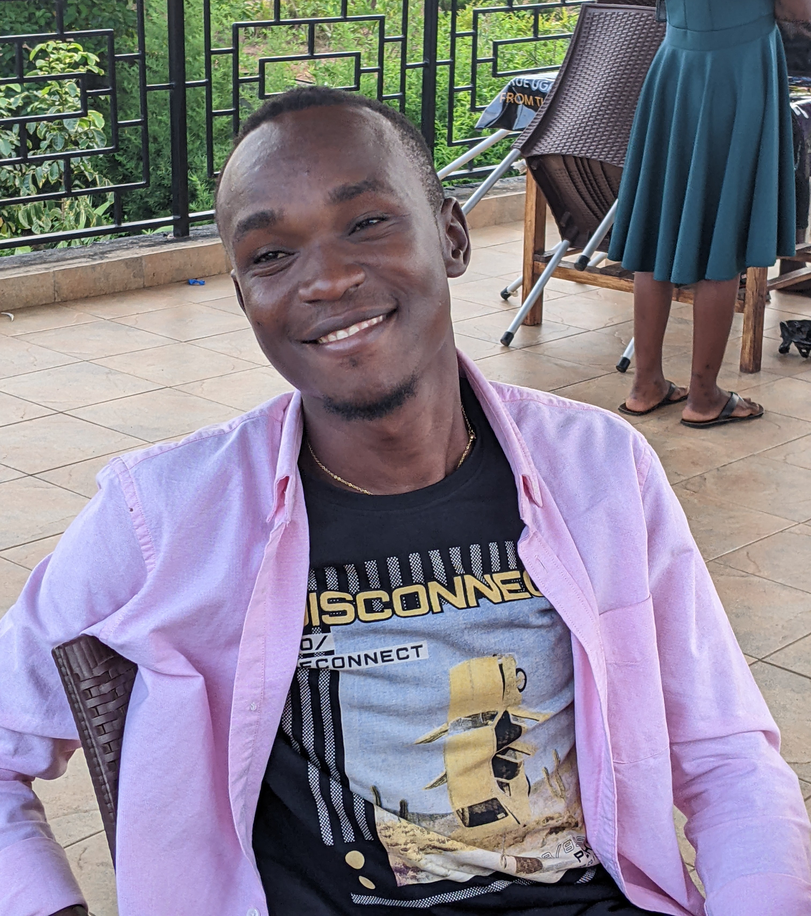
Team Members
Nuwarimpa Victor
Ssekyanzi
Brian
Opolot Job
Emmy Wasa

Slide 4
Challenge: Beyond Sunlight: An Aquatic Chemosynthetic world
“Limited public awareness about the aquatic Chemosynthetic world by providing first-hand information on how life thrives in the ocean world.“

Slide 5
80% - 90%
Of the people the in world are ingnorate or know little about the aquatic life

Slide 6
Our Focus
Unlike photosynthesis, we what to bring to your attention that chemosynthesis supports life in environments without sunlight, yet it remains under recognized. This lack of awareness limits understanding of its crucial role in sustaining ecosystems in extreme conditions. Chemosynthetic Realm platform addresses these gaps.

Slide 7
Our Solution
Increasing public awareness through creating an Chemosynthetic Realms web platform which can highlight the importance of chemosynthesis in extreme environments with no or limited sunlight.

Slide 8
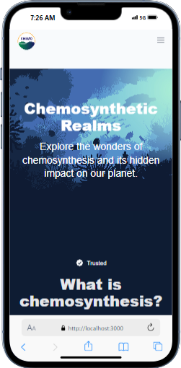
Mobile view project
Accessible on mobile and fully responsive.

Slide 9
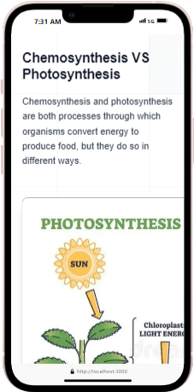
Mobile view project
Accessible on mobile and fully responsive.

Slide 10
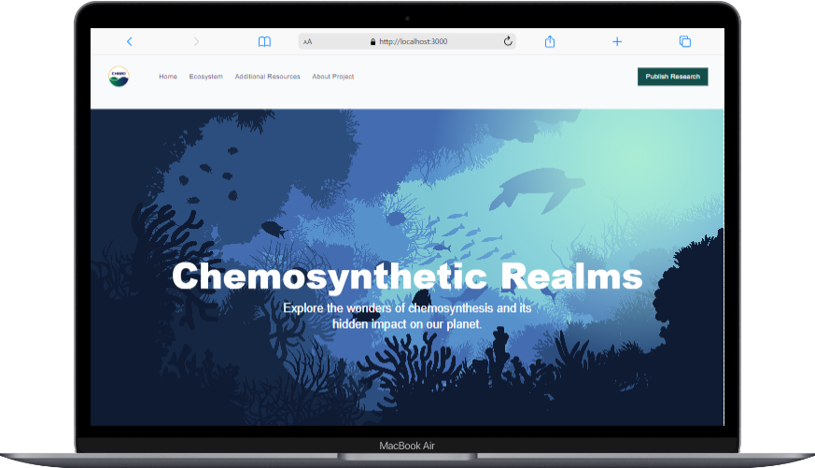
Desktop view project
Accessible on mobile and fully responsive.

Slide 11
Thanks for watching

